Slide 1
Development of master curricula for natural disasters risk management in Western Balkan countries
WP2.1 & WP2.2 Development of master curricula in WB HEIs
Prof. Giuseppe Tito Aronica
University of Messina – Department of Engineering, ITALY
Slavisa Trajkovic, Milan Gocic
University of Nis, Serbia
Vienna, Austria, PMC meeting, 06th April 2017
Project number: 573806-EPP-1-2016-1-RS-EPPKA2-CBHE-JP
"This project has been funded with support from the European Commission. This publication reflects the views only of the author, and the Commission cannot be held responsible for any use which may be made of the information contained therein"

Slide 2
Development of master curricula for natural disasters risk management in Western Balkan countries
WP2 timing
 |  | 2017 |  |  |  | 2018 |  |  |  | 2019
 |  | I | II | III | IV | I | II | III | IV | I | II | III | IV
WP 2 |  | 15/3 |  |  |  |  |  |  |  |  |  | 14/10
Deliverables | 2.1 |  |  | X
 | 2.2 |  |  |  | X
 | 2.3
 | 2.4 |  |  |  |  |  |  |  |  |  |  | X
 | 2.5
X = Report

Slide 3
Development of master curricula for natural disasters risk management in Western Balkan countries
WP Deliverables
2.1 - Defined aims, specific competencies and learning outcomes of master curriculum per HEI in WB – Catalogue of courses
Description
In order to develop master curriculum per HEI in WB, the aims, specific competences and learning outcomes, as well as teachers' competencies that will held courses for master curriculum in the field of risk management of natural disasters will be defined.
Target groups: Teaching staff, students

Slide 4
Development of master curricula for natural disasters risk management in Western Balkan countries
WP Deliverables
2.2 - Defined courses content and syllabi
Description
The effective courses design will be guided by each WB HEI decision about wanted competences of graduate students.
The syllabi will consist of the following components: course description (course content, learning objectives, characteristics of class meetings, logistics), course topics and assignments (schedule of topics, readings and assignments, projects and exams), course policies and values (inclusiveness, integrity, responsibility, expectations for success).
The design of all proposed curricula will be discussed with experts from EU partner institutions.
Target groups: Teaching staff, students, administrative staff

Slide 5
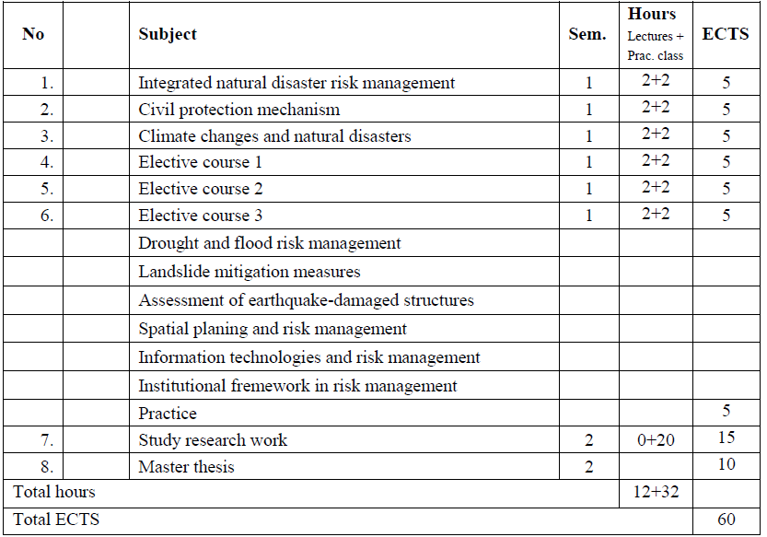
Development of master curricula for natural disasters risk management in Western Balkan countries
UNI – MAS - Natural disaster risk management

Slide 6
Development of master curricula for natural disasters risk management in Western Balkan countries
UPKM – MAS - Natural disaster risk management
 | 1. semester
 | Subjects | ECTS | status
1 | Natural Disaster | 5 | M
2 | Disaster Mitigation and Safety Education | 5 | E
3 | Monitoring in prevention, recording and estimation of Natural disasters | 5 | E
4 | Natural disasters risk assesment | 5 | M
5 | Information technologies in Natural Disasters Management | 5 | E
6 | Transportation Systems | 5 | E
7 | Environmental Risk | 5 | E
8 | Spatial Planing and risk management | 5 | M
9 | Hydrosphere Disaster | 5 | E
10 | Earthquake Disaster | 5 | E
11 | Fire Disaster | 5 | E
12 | Geodisaster | 5 | E
 |  | 30
 | 2. semester
 | Course | ECTS | status
1 | Disaster Response and Recovery | 5 | M
2 | Systemic mitigation measures | 5 | E
3 | Power suppply in Post Disaster Period | 5 | E
4 | Emergency Service Organization | 5 | E
4 | Post disaster measures in waste, water and sewer management | 5 | E
5 | Urban Design for Disaster Mitigation | 5 | E
6 | Natural disasters with participation of chemical agents | 5 | E
7 | Crysis Management and Communication | 5 | E
9 | Landslides Mechanisms and Numerical Modeling | 5 | E
10 | Master Thesis | 15 | M
 |  | 30

Slide 7
Development of master curricula for natural disasters risk management in Western Balkan countries
KPA – MAS - Natural disaster risk management
 |  |  |  | I semester |  |  | II semester |  |  | Total | ECTS
No | Code |  | Course title | L | P | RW | L | P | RW
First semester
1. | 14.1 |  | Scientific methodology | 3 | 1 | 1 |  |  |  | 75 | 10
2. | 14.2 |  | Risk management | 3 | 1 | 1 |  |  |  | 75 | 10
3. | 14.3 |  | Elective course 1 | 3 | 1 | 1 |  |  |  | 75 | 10
4. | 14.4 |  | Elective course 2 | 3 | 1 | 1 |  |  |  | 75 | 10
TOTAL |  |  |  | 12 | 4 | 4 |  |  |  | 300 | 40
Second semester
5 | МР |  | Master thesis |  |  |  |  |  |  |  | 20
TOTAL |  |  |  |  |  |  |  |  |  |  | 20
Elective courses
1. | 14.5 | Rescue operations in natural disasters
2. | 14.6 | Risk modeling in natural disasters
3. | 14.7 | Information and communication technologies in natural disasters risk management
4. | 14.8 | Prevention and elimination of serious crime in terms of natural disasters
5. | 14.9 | Law on protection and emergency situations
6. | 14.10 | Police and natural disasters
7. | 14.11 | Crisis management and communications in natural disasters
8. | 14.12 | Business continuity management in terms of natural disasters
9. | 14.13 | Management of migration in terms of natural disasters
TOTAL |  |  |  | 20 |  |  |  |  |  | 300 | 60

Slide 8
Development of master curricula for natural disasters risk management in Western Balkan countries
UNSA – MAS - Natural disaster risk management
 | I YEAR 1. semester | I SEMESTER
 | Subjects | Lecture | Exercises | ECTS | status
1 | Natural Hazards, Risk and Engineering | 2 | 2 | 5 | B
2 | GIS and statistics | 2 | 2 | 5 | E
3 | Geodesy (topo- modely) | 2 | 2 | 5 | E
4 | Geomodelling | 2 | 2 | 5 | E
5 | Meteorology and Hydrology | 2 | 2 | 5 | B
6 | Daljinska detekcija | 2 | 2 | 5 | E
7 | Hidromehanika | 2 | 2 | 5 | E
8 | River engineering | 2 | 2 | 5 | E
9 | Geotechnics and Geology | 2 | 2 | 5 | E
10 | Spatial Planing and risk management | 2 | 2 | 5 | B
11 | Structural dynamics | 2 | 2 | 5 | E
12 | Engineering Seismology & Earthquake Geotechnics | 2 | 2 | 5 | E
13 | Finite Element Method in Civil Engineering | 2 | 2 | 5 | E
 |  | TOTAL |  | 30
 | I YEAR 2. semester | I SEMESTER
 | Subjects | Lecture | Exercises | ECTS | status
1 | River flood Management | 2 | 2 | 5 | E
2 | River basin management | 2 | 2 | 5 | E
3 | Geostatistika | 2 | 2 | 5 | B
4 | Drought Management | 2 | 2 | 5 | B
5 | Fluvial geomorphology | 2 | 2 | 5 | B
6 | Fire Management | 2 | 2 | 5 | E
7 | Seismic Design of Structures | 2 | 2 | 5 | B
8 | Advanced Finite Element Method in Civil Engineering | 2 | 2 | 5 | E
9 | Landslides Mechanisms and Numerical Modeling | 2 | 2 | 5 | E
 |  | TOTAL |  | 30

Slide 9
Development of master curricula for natural disasters risk management in Western Balkan countries
UNSA – MAS - Natural disaster risk management
 | II YEAR 3. semester | I SEMESTER
 | Subjects | Lecture | Exercises | ECTS | status
1 | Flood risk mangement | 2 | 2 | 5 | E
2 | Debris flow and flood management | 2 | 2 | 5 | E
3 | Integrated Water Management | 2 | 2 | 5 | E
4 | Risk projecting and evaluation | 2 | 2 | 5 | B
5 | Numerical Modelling | 2 | 2 | 5 | B
6 | Advanced Seismic Design of Structures | 2 | 2 | 5 | E
7 | Risk projects and Assessment of Existing Structures | 2 | 2 | 5 | E
8 | Seismic Vulnerability Reductions | 2 | 2 | 5 | E
9 | Experimental structural evaluation and rehabilitation | 2 | 2 | 5 | E
10 | Assessment and rehabilitation of Monuments and Historical Constructions | 2 | 2 | 5 | E
11 | In-situ Testing and Monitoring | 2 | 2 | 5 | E
12 | Landslide Mitigation Measures | 2 | 2 | 5 | E
 |  | TOTAL |  | 30
 | II YEAR 4. semester | II SEMESTER
 |  |  |  | ECTS
1 | Thesis project:
2 | Flood management |  |  | 30
3 | Eartquake |  |  | 30
4 | Landslide |  |  | 30
 |  | TOTAL |  | 30

Slide 10
Development of master curricula for natural disasters risk management in Western Balkan countries
UNID – MAS - Disaster Risk Management and Fire Safety
No | Code | Course title | Semester | Type | Status | Hours |  |  |  | ECTS
 |  |  |  |  |  | L | P | RW
1. | МАS01 | Natural disasters | 1. |  | M | 2 | 2 |  |  | 5
2. | МAS 02 | Risk management | 1. |  | M | 2 | 2 |  |  | 5
3. | МАS 03 | Protection and rescue system | 1. |  | M | 2 | 2 |  |  | 5
4. | МАS 04 | Scientific methodology | 1. |  | M | 2 | 2 |  |  | 5
5. | Elective course 1
 | МАS 05 | Operational research | 1. |  | E | 2 | 2 |  |  | 5
 | МАS 06 | Decision support models | 1. |  | E | 2 | 2 |  |  | 5
6. | Elective course 2
 | МАS 07 | Public administration in emergency situations | 1. |  | E | 2 | 2 |  |  | 5
 | МАS 08 | GIS technologies in natural disaster management | 1. |  | E | 2 | 2 |  |  | 5
7. | МАS 09 | Emergency management | 2. |  | M | 2 | 3 |  |  | 6
8. | Elective course 3
 | МАS 10 | Operations support to civilian authorities in case of natural disasters | 2. |  | E | 2 | 3 |  |  | 6
 | МАS 11 | Safety management in natural disasters | 2. |  | E | 2 | 3 |  |  | 6
 | МАS 12 | Decontamination technologies | 2. |  | E | 2 | 3 |  |  | 6
9. | МАS 13 | Research work | 2. |  | M | 2 |  | 3 |  | 6
10. | МАS 14 | Master thesis | 2. |  | M |  |  | 9 |  | 12
Total |  |  |  |  |  | 18 | 18 | 12
Total ECTS |  |  |  |  |  |  |  |  |  | 60

Slide 11
Development of master curricula for natural disasters risk management in Western Balkan countries
TCASU – MAS - Disaster Risk Management and Fire Safety
No. | Code | Courses | S | Type | CourseStatus. | Hours |  |  |  | Other | ECTS
 |  |  |  |  |  | L | E |  | Oth.
FIRST YEAR
1. | 32731 | English language – higher course | 1 | - | О | 2 |  | 2 | 0 | - | 6
2. | 32732 | Research methods and scientific communications | 1 | - | О | 2 |  | 2 | 0 | - | 6
3. | 32733 | Protection and Rescue | 1 | - | О | 2 |  | 2 | 0 | - | 6
4. | 32734 | Fire Dynamics and Expertise | 1 | - | О | 2 |  | 2 | 0 | - | 6
Elective courses 1(elect 1 out of 2)
5. | 32735 | Hazardous matters and waste | 1 | - | E | 2 |  | 2 | 0 | - | 6
6. | 32736 | Information technologies and protection | 1 | - | E | 2 |  | 2 | 0 | - | 6
7. | 32737 | Fire report system | 2 | - | О | 4 |  | 3 | 0 | - | 7
8. | 32738 | Crises, emergencies and protection | 2 | - | О | 4 |  | 3 | 0 | - | 7
Elective courses 2 (elect 1 out of 2)
9. | 32740 | Management and development of human resources in the protection | 2 | - | E | 3 |  | 3 | 0 | - | 6
10. | 32741 | Sustainable development and environmental protection | 2 | - | E | 3 |  | 3 | 0 | - | 6
11. | 32742 | Professional Practice | 2 | - | О | 0 |  | 0 | 0 | 60 | 2
12. | 32743 | Specialist Thesis | 2 |  | О |  |  |  |  |  | 8
Total ECTS= |  |  |  |  |  |  |  |  |  |  | 60

